Slide 1
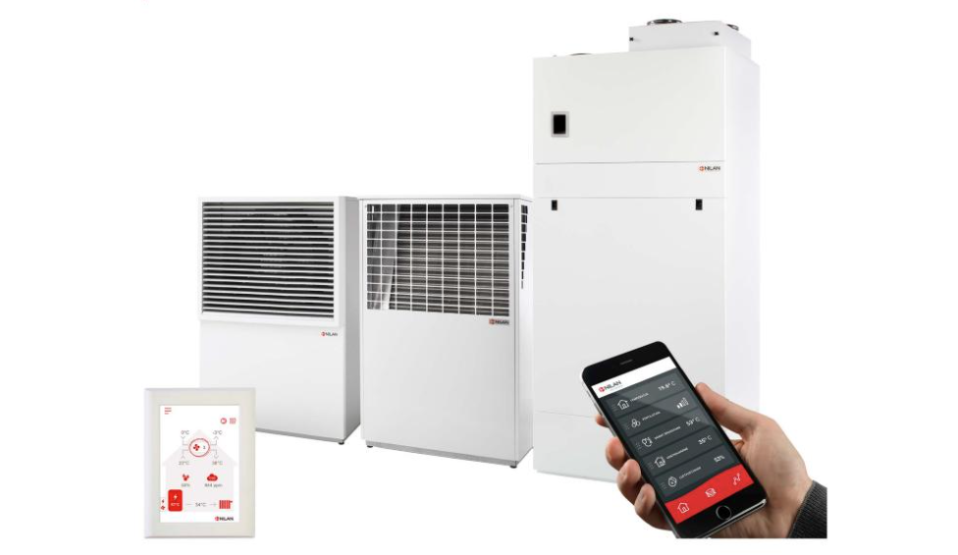
Compact P AIR
How to update software on CTS602 controller boards (new version of CTS602)

Slide 2
Control boards
PCB | Item number | Placed
Compact P | 239944 | Inside Compact P
Air inside | 239944 | Inside Compact P
Air outside | 239944 | Inside AIR-module
Remote | 239948 | Inside Compact P2 or in a box above Compact P.

Slide 3
Automatic programming of sub control boards via Compact P
Compact P AIR software package:
AIRPack_4.1.6.36_Air_4.1.6.36_Hmi_1.1.6.36_Remote_1.1.6.36.lep
Compact P software version 4.1.6.36
Air software version 4.1.6.36
HMI software version 4.1.6.36
Remote pcb software version 1.1.6.36

Slide 4
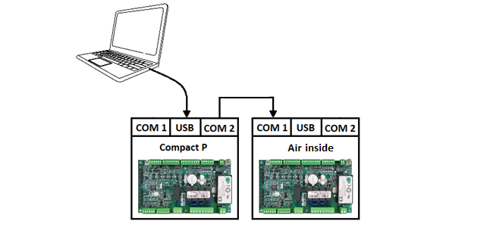
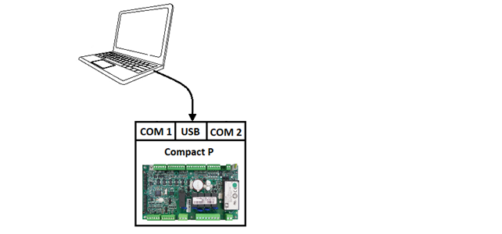
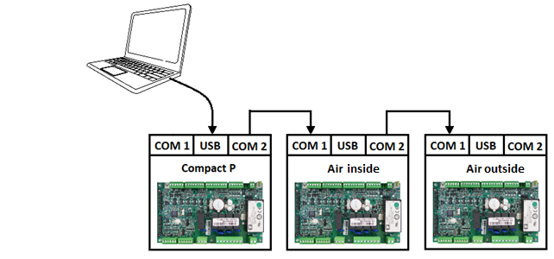
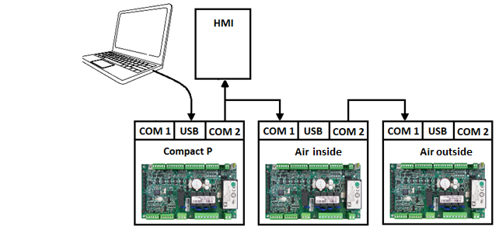
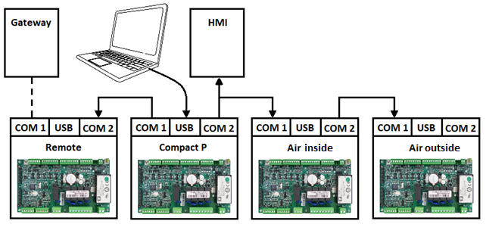
Automatic programming of sub control boards via Compact P
Compact P Programmed directly.
Air inside Programmed via Compact P
Air outside Programmed via Air inside
HMI Programmed via Compact P
Remote pcb Programmed via Compact P

Slide 5
Automatic programming of sub control boards via Compact P
Warning:
CTS602 sub control boards must have an old version of the right software, to be able to receive a new version automatically via Compact P!
Otherwise they must be programmed manually first time.

Slide 6
Manual programming of sub control boards
Software packages:
Air inside software version 4.1.6.36 AirIndePack_4.1.6.36_Ude_4.1.6.36.lep
Air outside software version 4.1.6.36 LMC320_AirUde_4.1.6.36.lep
Remote software version 1.1.6.36 RemoteModbus_1.1.6.36.lep

Slide 7
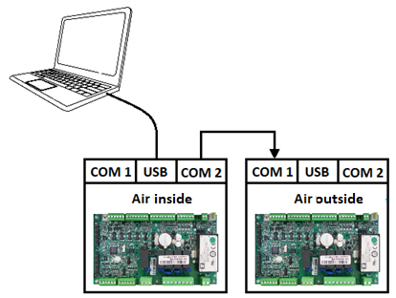
Manual programming of sub control boards
Air inside
Will also update Air outside.

Slide 8
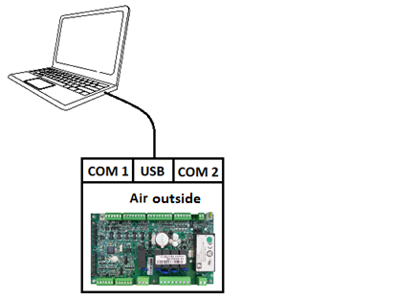
Manual programming of sub control boards
Air outside

Slide 9
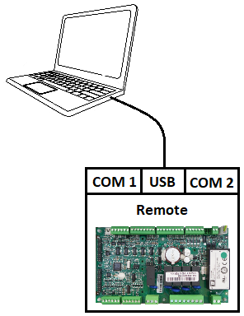
Manual programming of sub control boards
Remote

